Slide 1
SALES PERFORMANCE DASHBOARD – BUSINESS INTELLIGENCE OVERVIEW
Presented By: V.S.Balambiga Date: 28th June 2025 Tools Used: Power BI Desktop, Excel Dataset

Slide 2
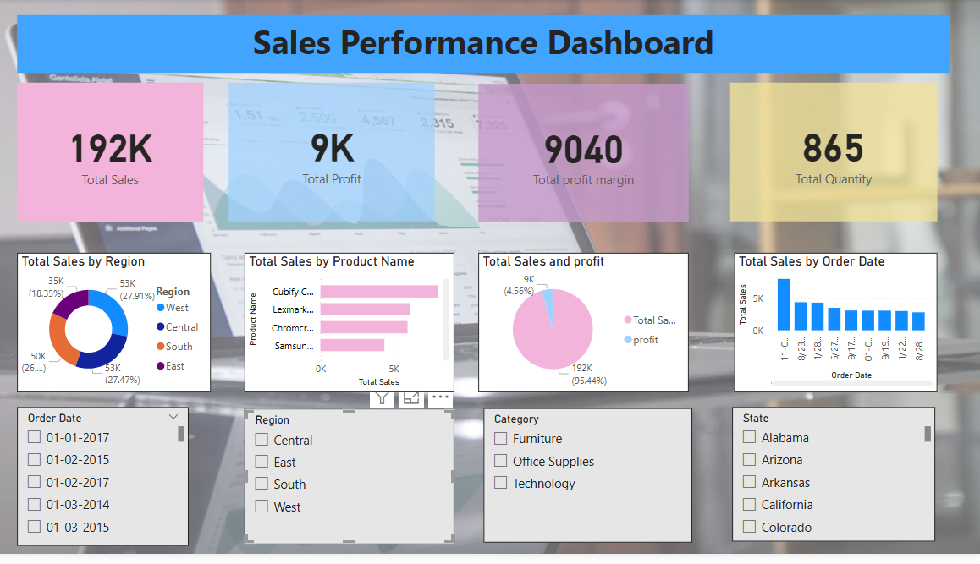

Slide 3
Objective and Purpose of the Dashboard
The main purpose of this dashboard is to present a comprehensive, interactive view of sales
performance data across different dimensions such as region, product, time, and state.
It is designed to help business stakeholders, managers, and analysts monitor critical sales KPIs,
identify trends, and make data-driven decisions.
It integrates multiple KPIs such as total sales, profit, quantity, and profit margin, enabling quick and
effective performance evaluation.
The dashboard acts as a single source of truth for tracking sales performance across product lines
and timeframes.

Slide 4
Key KPIs Summary (Cards Visuals)
Total Sales: 192K
This represents the overall revenue generated from sales activities.
It is the most critical metric and acts as the baseline for comparison with other KPIs.
Total Profit: 9K
Indicates the net profit earned after subtracting costs from total sales.
Helps gauge the financial efficiency of sales operations.
Total Profit Margin: 9040
Reflects how much profit is made per unit sale or overall—used to measure profitability and operational margins.
Total Quantity: 865
Indicates the total units/items sold, offering insight into sales volume irrespective of price.

Slide 5
Data Visualizations Overview
Donut Chart – Total Sales by Region:
Shows the contribution of each region (West, Central, South, East) to total sales.
Highlights that East and Central regions lead with 53K each, followed by South (50K) and West (35K).
Allows easy regional comparison and identification of high-performing areas.
Bar Chart – Total Sales by Product Name:
Displays the total sales value for each product.
Helps businesses identify top-selling products like Cubify, Lexmark, and Samsung.
Useful for product-level strategy, promotions, and inventory planning.
Pie Chart – Total Sales vs Total Profit:
Visualizes the proportion of revenue vs profit.
Shows that sales constitute the majority (~95.44%), while profit is a smaller share (~4.56%), implying potential cost optimization areas.
Column Chart – Total Sales by Order Date:
Helps track sales trends over different order dates.
Reveals specific high-performing dates (e.g., 11-01, 12-01), enabling seasonal or date-based analysis.

Slide 6
Slicers for Interactivity
Order Date Slicer:
Enables filtering data by specific transaction/order dates.
Useful for time-series analysis and identifying seasonal spikes or sales dips.
Region Slicer:
Lets users filter sales data by specific geographic regions.
Provides clarity on how different regions are performing.
Category Slicer:
Segregates sales data by product categories like Furniture, Office Supplies, and Technology.
Facilitates category-wise analysis and marketing strategies.
State Slicer:
Allows filtering data based on U.S. states like Alabama, California, Colorado, etc.
Helps businesses focus on localized marketing efforts and performance evaluation.

Slide 7
Business Insights & Observations
Central and East regions contribute the highest total sales, indicating strong demand or better sales strategies in those areas.
Some products clearly outperform others; promoting these can lead to revenue maximization.
The sales to profit ratio reveals a gap, which might be improved by reducing costs or optimizing pricing models.
Sales spike on specific dates, hinting at events, campaigns, or seasonal trends – an opportunity for targeted marketing.
Using filters, stakeholders can dynamically assess sales per region, per category, or over time – boosting data-driven planning.

